Slide 1

Energy Outlook Project 1

Slide 2
Introduction – Team 4
Flora
Sylviane
Krishan
Harish

Slide 3
Project Overview
We live in a time of great challenges. Our homes businesses and schools need vast amount of energy. But also great opportunities, especially in the energy sector to protect and restore a healthy planet.
Our focus for this project is on Energy consumption, generation, capacity, Region and Fuel Type.
Key Questions / Challenges we address in this project:
What is the Energy Consumption by region?
Energy consumption vs generation by State
Where does Our Power Come from in the United States?
Why Renewable Energy Matters?
Does each state generation have any correlation with demographic?
How do we leave behind a sustainable planet for the next generation?

Slide 4
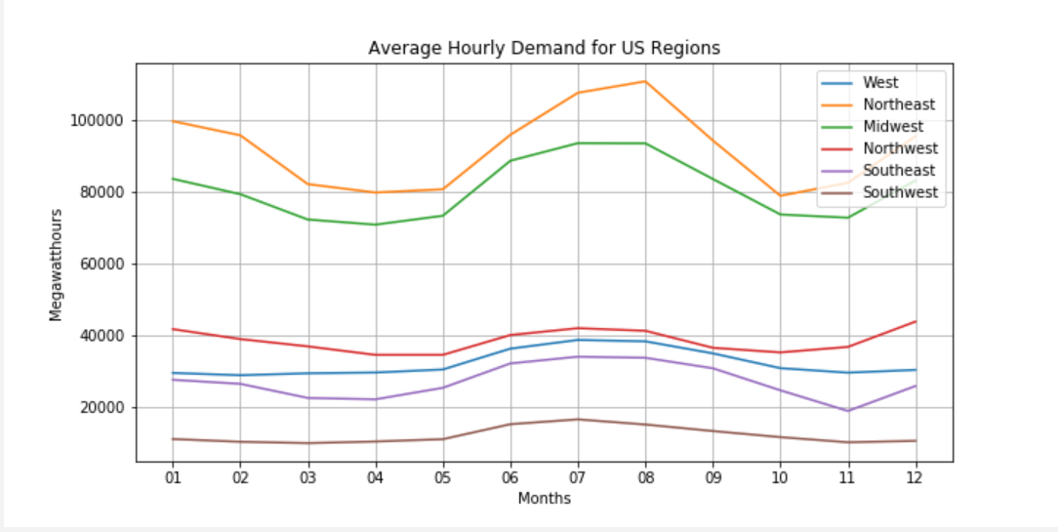
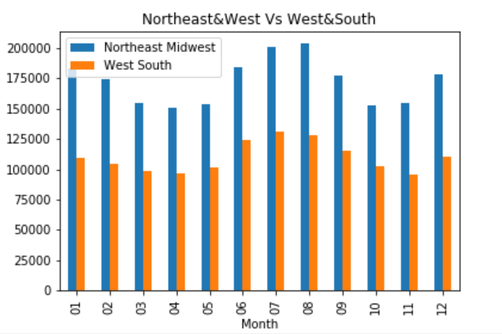
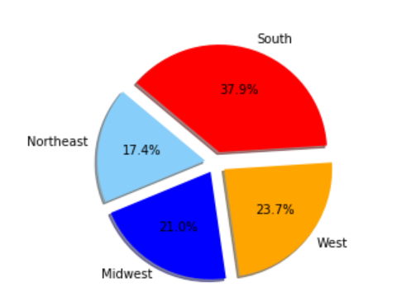
Energy Outlook
Average Hourly Consumption of electricity
Hourly demand of regions in USA
Which region has more consumption during the peak and non peak seasons.
Shape of the curve (varies steep or flat) affect investment in the fundamental infrastructure.

Slide 5
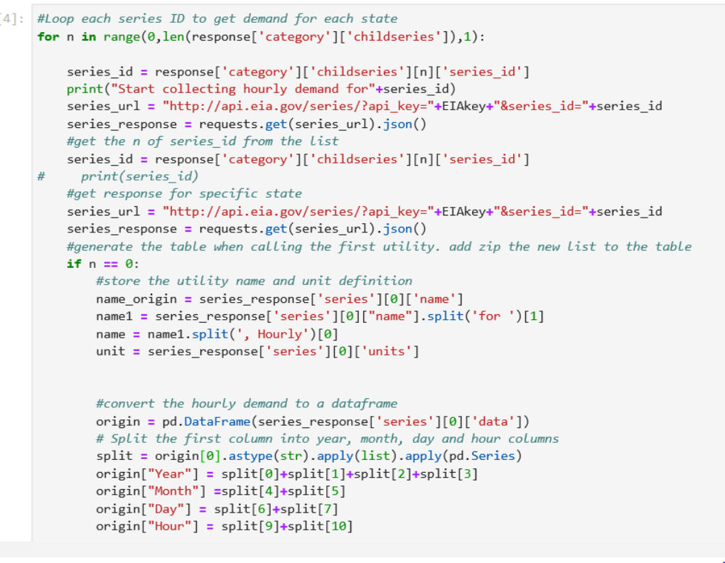
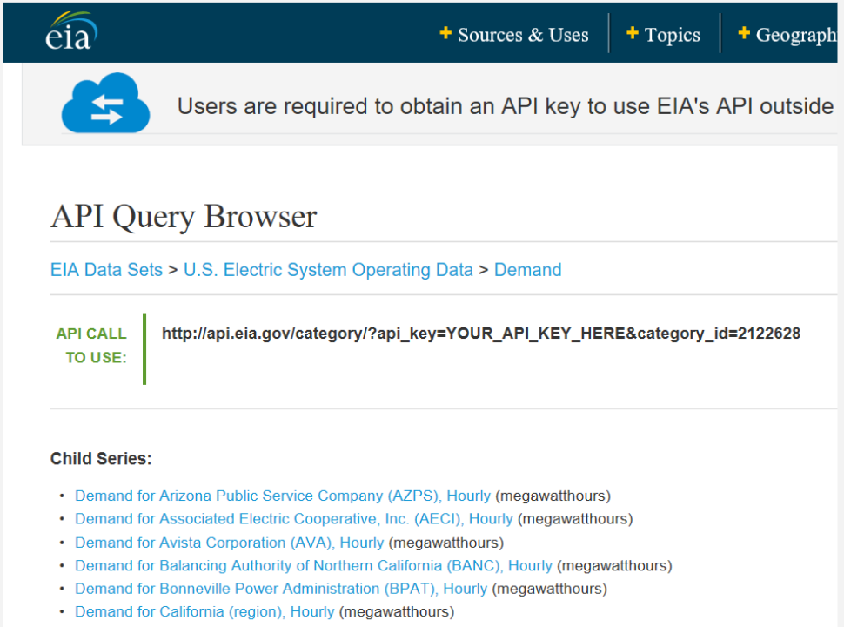
Data Story
Site used to download data :
https://www.eia.gov/

Slide 6
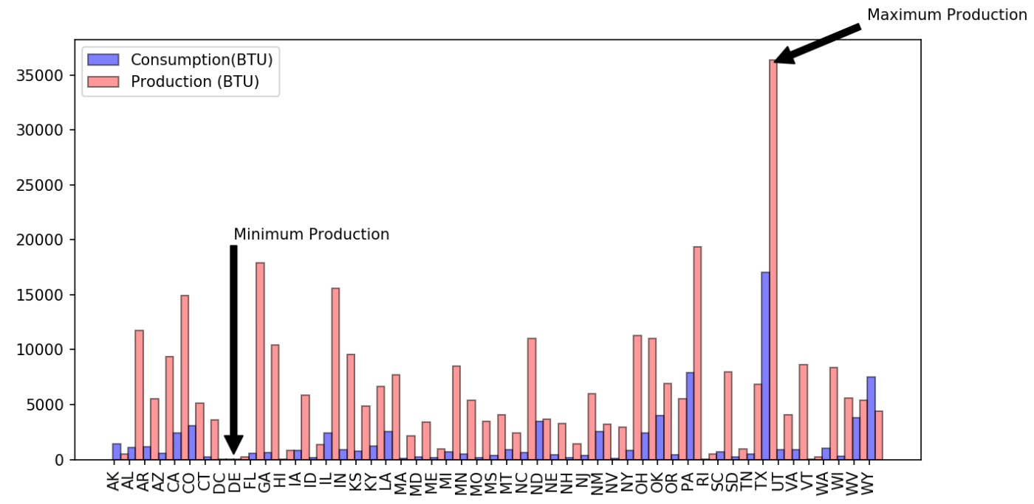
Energy Outlook
Consumption vs Generation to determine which states have large surplus
Texas and Pennsylvania have maximum production of energy.
They have surplus energy which can be sold to other states and countries.
Delaware & Washington DC have low consumption and production as well.
State with surplus energy will have more opportunity for Small business, Malls and House constructions.
Data download from:
https://www.eia.gov/

Slide 7
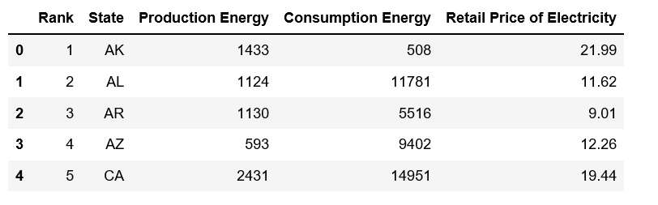
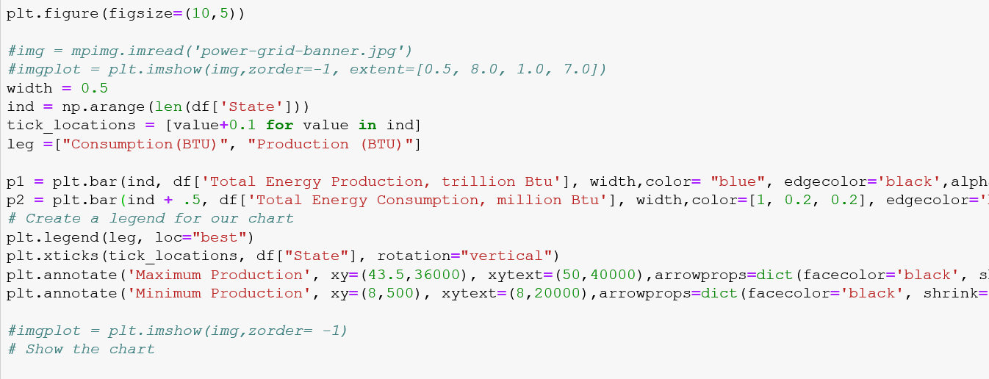
Data Story
Site used to download data :
https://www.eia.gov/

Slide 8
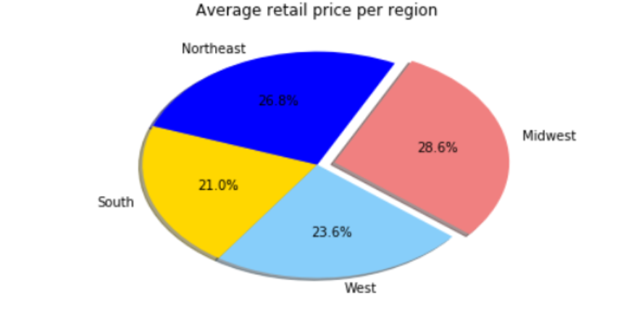
Energy Outlook
Average price per region
Midwest energy prices are the highest by region.
Hawaii has the highest price for all regions.
In summer the south has the highest consumption

Slide 9
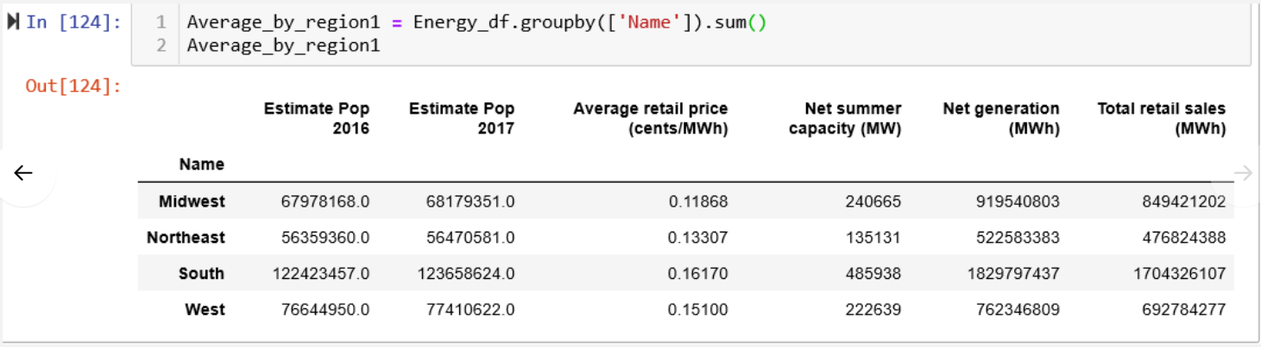
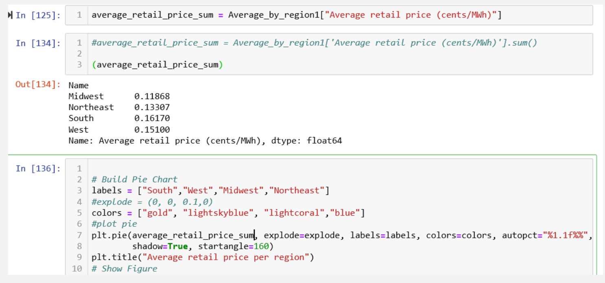
Data Story

Slide 10
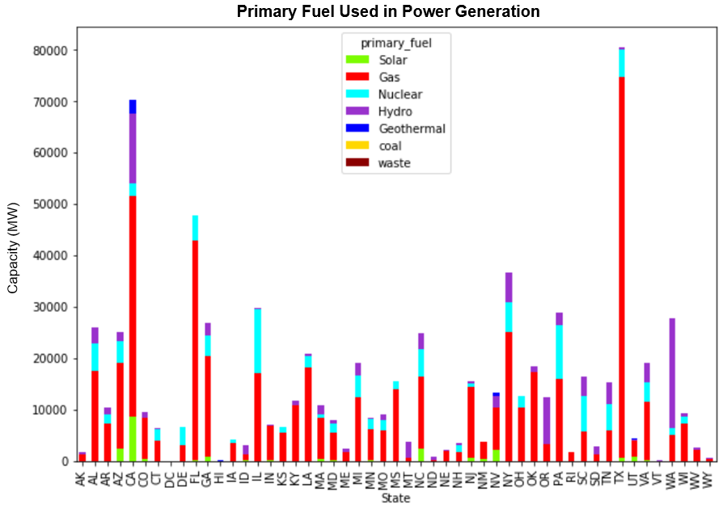
Energy Outlook
Top states for renewable energy generation - 2016
Highlights the dual challenge of ensuring the United States has access to affordable and reliable energy supplies to support prosperity while reducing environmental impacts – including the risks of climate change
Data & plot graph shows California & Texas produce more energy from Gas. Washington is the highest producer of Hydro Energy. Georgia and Pennsylvania are the largest producers of Nuclear Energy.
Nationwide, in the United States only 3% of our energy comes from renewable energy sources.

Slide 11

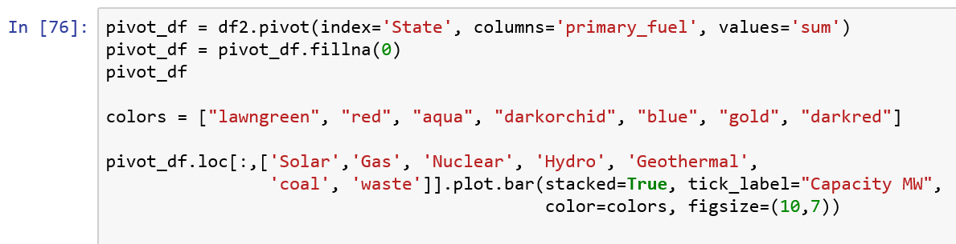
Data Story
The Global Power Plant Database is a comprehensive, open source database of power plants around the world. It centralizes power plant data to make it easier to navigate, compare and draw insights for one’s own analysis. Each power plant is geolocated and entries contain information on plant capacity, generation, ownership, and fuel type.
https://www.wri.org/publication/global-power-plant-database

Slide 12
What we would have done with more time?
Use data from multiple years and project consumption and generation.
Use prediction to determine when our current energy consumption would cross over generation?
Find out more about “rejected energy” - a fancy term for energy that is produced but not used in an effective way.
Work on other correlations such Energy Vs Rate of Economic development.

Slide 13
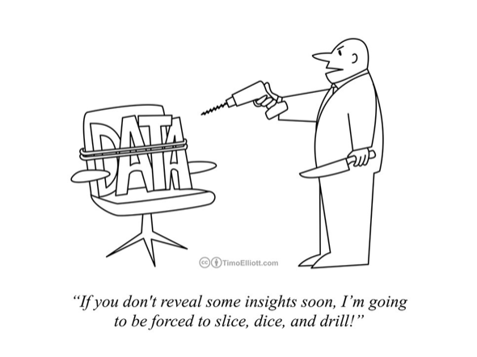

Slide 14

Thank you!

